Slide 1
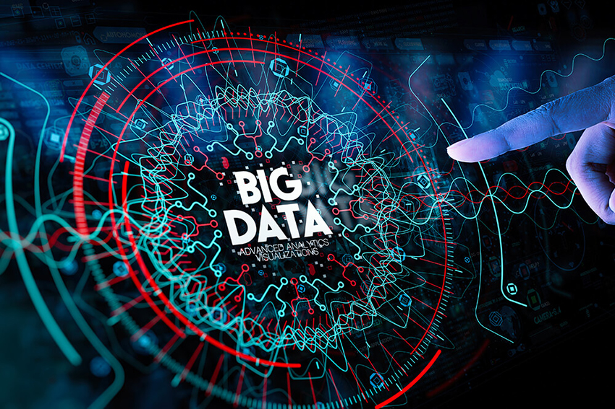

Big Data
Presented By: Bishnu Neupane
Class 12 Computer Science

Slide 2
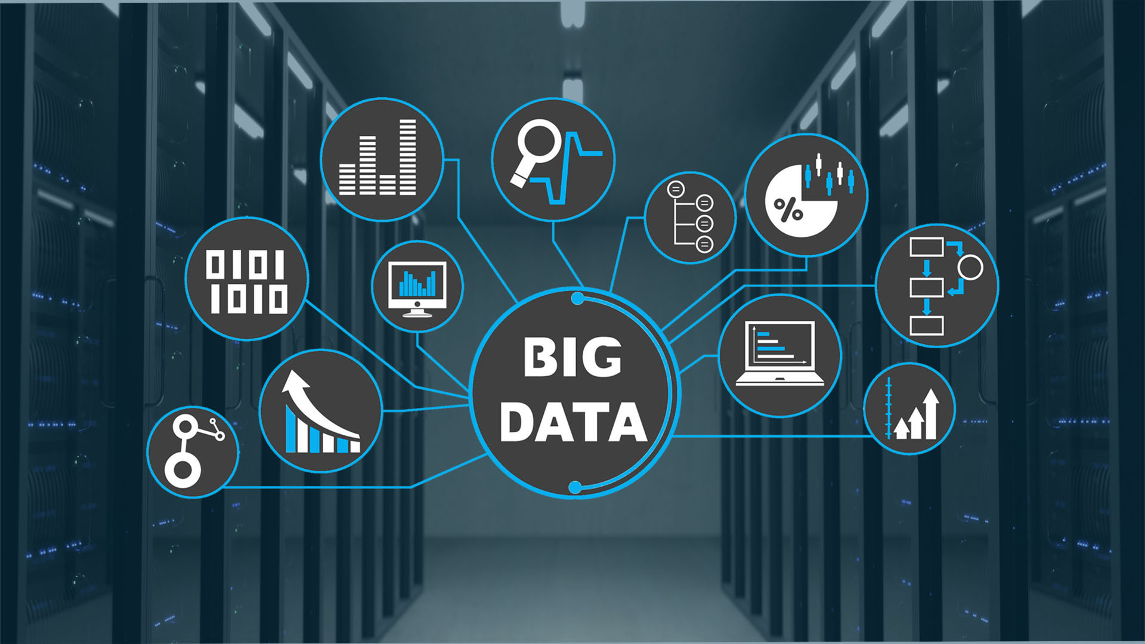

What is Big Data?
A lot of data and information
Big Data refers to large sets of data that cannot be processed easily. It includes data from various sources, such as social media, online transactions, and sensors.

Slide 3
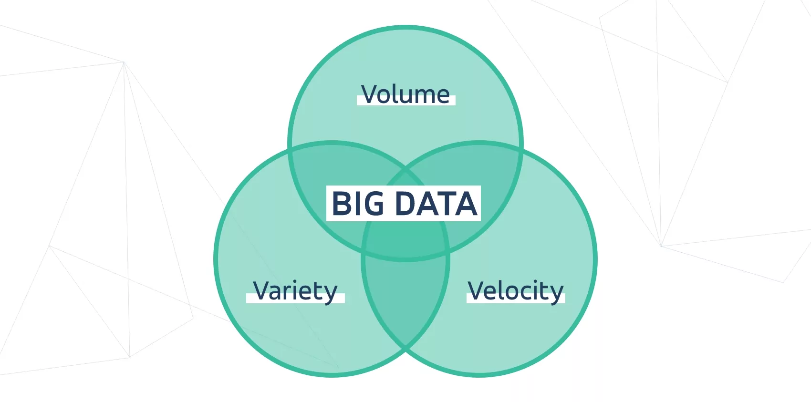

Features of Big Data
Understanding the key characteristics
Volume
Big Data involves massive amounts of information that can exceed terabytes. This large volume of data comes from various sources, making it difficult to manage using traditional methods.
Velocity
Variety
The speed at which data is generated and processed is crucial. Fast data processing allows businesses to respond quickly to new information and changes in their environment.
Big Data comes in many different formats such as text, images, and videos. This diversity of data types requires special tools for effective analysis and storage.

Slide 4

Types of Big Data
Understanding different data categories
Structured
Semi-structured
Unstructured
Structured data is organized in a clear format, such as databases. It is easy to search and analyze because it follows a fixed structure, like tables.
Semi-structured data does not have a strict format, but it still contains tags or markers. Examples include XML files or JSON data, making it easier to analyze than unstructured data.
Unstructured data has no predefined format or organization, making it complex to process. Examples include text documents, images, and videos, which require advanced techniques for analysis.

Slide 5
Sources of Big Data
Where data comes from
Social Media
Internet
Devices
Social media platforms like Facebook and Twitter generate vast amounts of data daily. This data includes user interactions, posts, and comments, which offer valuable insights into trends and behavior.
The internet is a major source of Big Data. Websites, online transactions, and user-generated content create significant volumes of structured and unstructured data that organizations analyze for various purposes.
Devices such as smartphones, IoT sensors, and smart appliances contribute to Big Data by collecting and transmitting data continuously. This information helps improve services and develop innovative solutions for users.

Slide 6
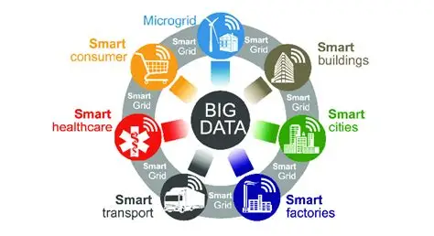
Uses of Big Data
Applications in various fields
Business
Education
Health
Big Data helps businesses analyze customer trends and preferences. It enables companies to make informed decisions that can lead to improved sales and better customer satisfaction.
In education, Big Data allows institutions to track student performance and engagement. This information can be used to personalize learning experiences and improve educational outcomes for all students.
Big Data is essential in healthcare for analyzing patient data and outcomes. It supports better diagnosis, treatment plans, and helps in managing resources efficiently in hospitals and clinics.

Slide 7
Advantages of Big Data
Key benefits for modern applications
Fast Processing
Better Decisions
Improved Insights
Big Data allows for quick data analysis, enabling businesses to respond to trends almost in real-time. This efficiency helps in making timely decisions based on current data.
By analyzing large datasets, organizations can uncover valuable insights that lead to informed decisions. This clarity helps in identifying opportunities and risks effectively.
Big Data provides a deeper understanding of customer behaviors and preferences, resulting in enhanced insights. These insights help tailor products and services to meet consumer needs.

Slide 8
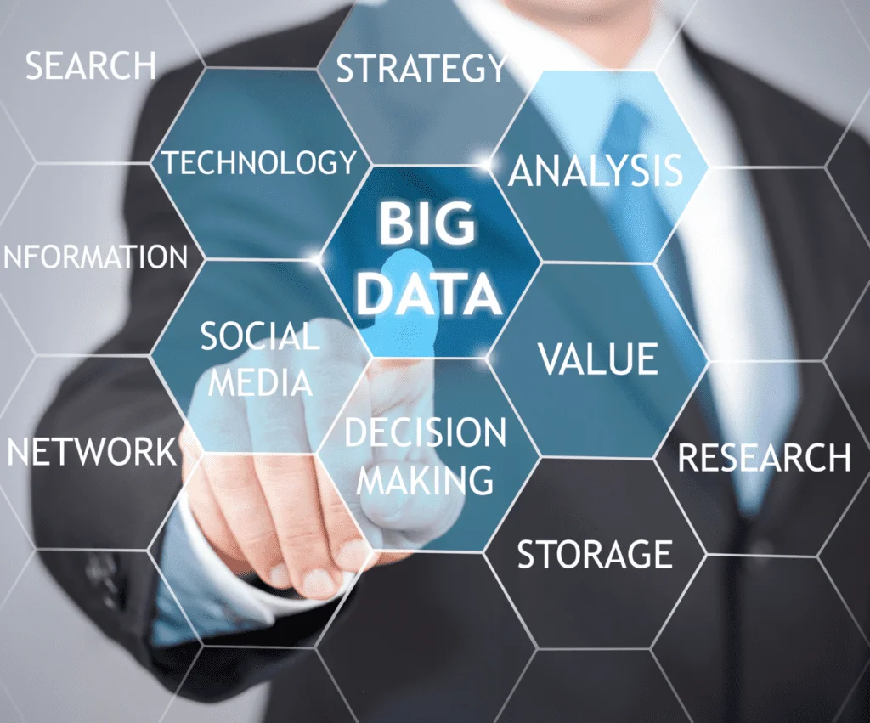
Problems of Big Data
Key challenges in managing data
Cost
Storage
Managing big data can be expensive, involving high costs for storage systems, processing power, and secure networks. Organizations must balance benefits with these significant financial investments.
Storing large amounts of data requires advanced technology and infrastructure. Traditional storage methods may be inadequate, leading to data loss or access issues.
Security
As data grows, so do the risks. Protecting sensitive information from cyber threats is crucial, requiring enhanced security measures and protocols to ensure data integrity and privacy.

Slide 9
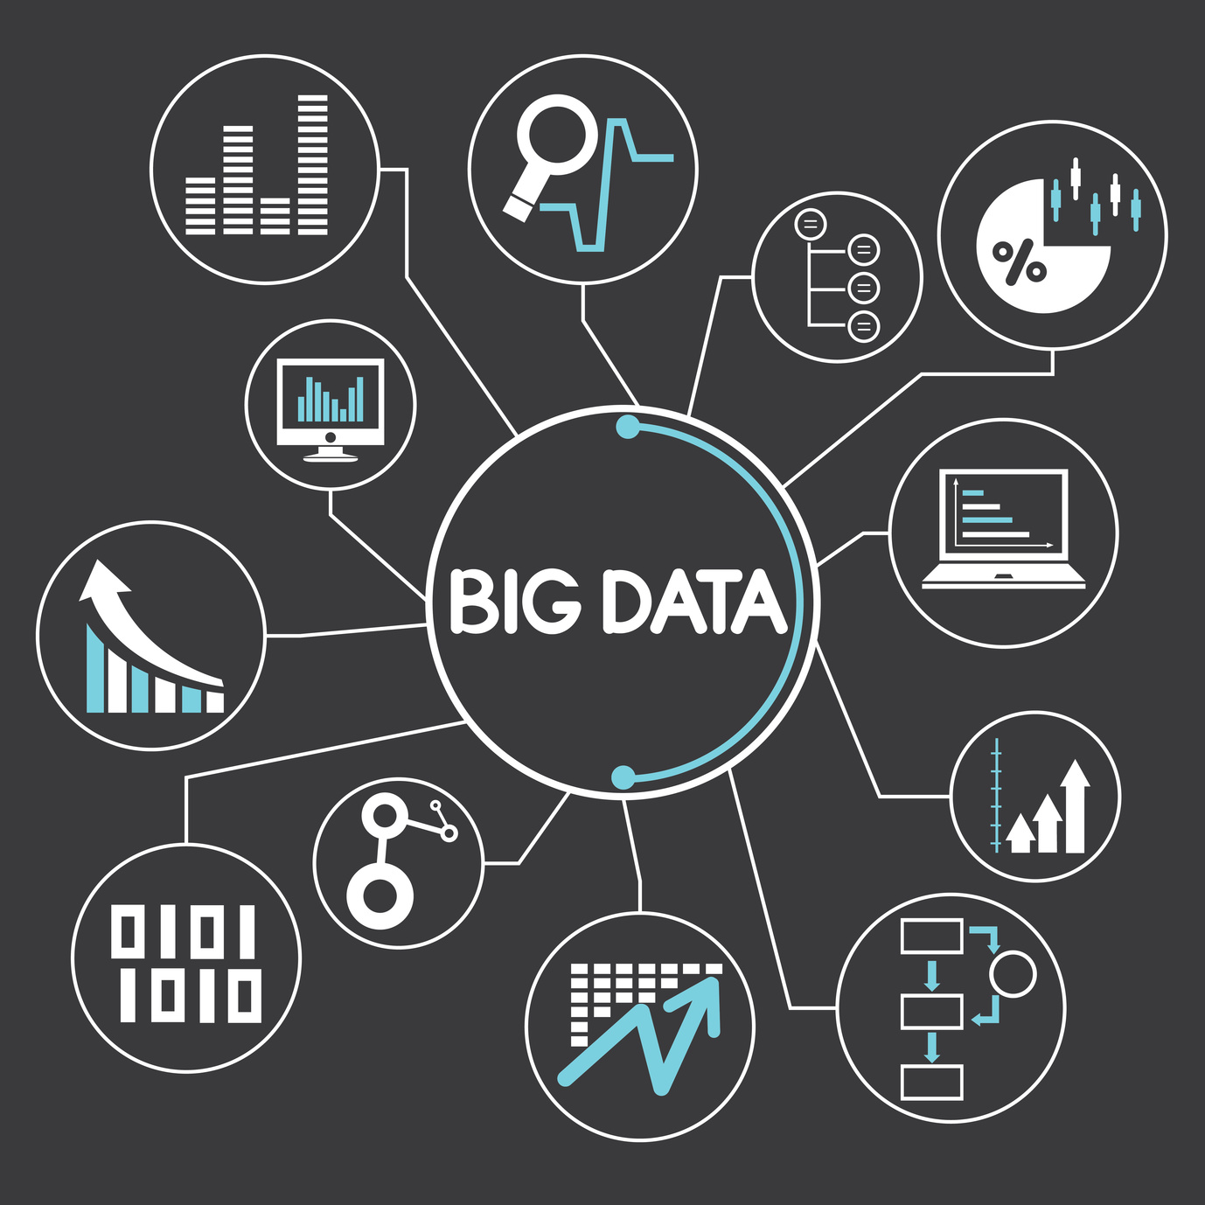

Conclusion
The era of Big Data marks a transformative period in data analysis, driven by the convergence of vast data availability, low-cost hardware, and advanced analytic tools. This combination has enabled organizations to process and analyze massive datasets quickly and cost-effectively, unlocking unprecedented opportunities for efficiency, productivity, and profitability.
Big Data provides scalable, flexible, and high-performing tools that empower businesses to derive actionable insights in real time. However, the rapid evolution of tools and technologies in this domain presents challenges in keeping pace and selecting the right solutions. Platforms like AWS offer managed services to simplify the collection, processing, and analysis of Big Data, allowing organizations to focus on solving business problems rather than managing infrastructure.
Understanding the power of Big Data

